Slide 1

PROBLEM SOLUTION BY:
The_Initiators

Slide 2
PROBLEM STATEMENT
THEME: AUTOMATION CHALLENGE: #2
TITLE: Discussion Forum for Community assistance – For DRYiCE
The solution should build a discussion forum for all users seeking assistance. The solution should allow providing of solutions, marking solution as answering solution, rating of proposed solutions, rating of the users providing answers, and tagging of users on the assistance requests. A crawler of feedback provided by users on specific topics in social media. The solution should also aggregate the feedback and perform a sentimental analysis on the feedback provided.

Slide 3
Basic Idea: -
We will design a Webpage of Discussion Forum for community assistance for DRYiCE technology. This Webpage can be viewed by anyone seeking assistance but only authenticated users can either ask the question or answer the question.
The questions can be posted on this forum category wise and they can be answered either by authenticated users or by the admin(‘Members of the company’) itself.
There will also be ratings of the user which will be based upon the no of questions answered, upvotes and downvotes received and users with rating more than or equal to ‘4’ can also be followed by other users.
Users can also start a discussion on any topic in which any member can participate and whose notification will be sent to all the active members (the one who have subscribed for the notification of discussion via mails).
Admin can also see the analysis of the users’ views about the product in the form of a graph which will be automated and obtained by the comments of people on the social sites.
Modules:- Registeration, Login, View Forum , Ask Question, Answer Question , Sentimental Analysis, Trending Question.

Slide 4
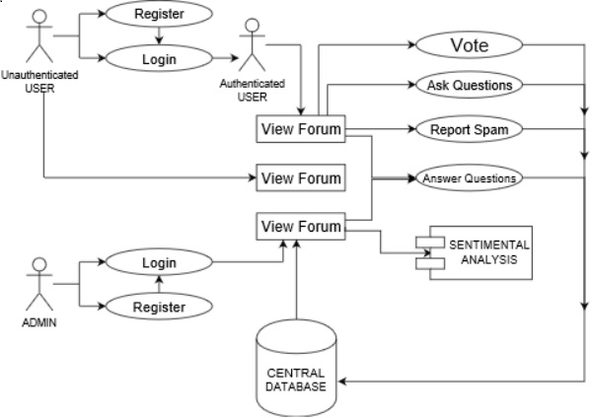
Use Cases: View Forum:- It Will contain the question-answer,product categories wise. Only the members of community can further use it while others can read the forum. Search Option:- This feature will help the user to search the questions in terms of ‘product title’,’hashtags’, ’keywords’.

Slide 5



Technology Stack:
Show Stopper: Automated Sentimental Analysis feature will be used so that company can know the users view about their product and also can make improvement in their product on the basis of response collected. If response is positive then that means people are happy with their services, if its negative then that means that there is a need of improvement. This feature will help in getting the users feedback in a better way .The feedbacks about the product will be collected through the social websites using a crawler.

